Slide 1
Chef

Slide 2
Introduction
Chef helps you express your infrastructure policy – how your software is delivered and maintained on your servers – as code.
When infrastructure is code, it becomes more maintainable, versionable, testable, and collaborative.

Slide 3
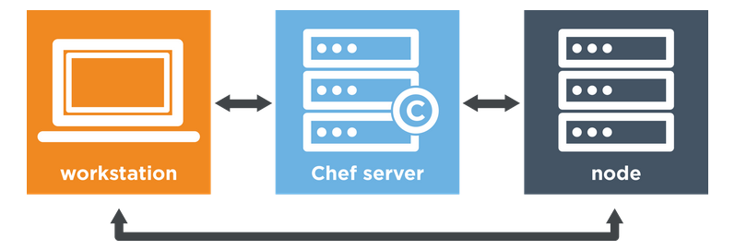
Know Your Chef
Typically, Chef is comprised of three parts – your workstation, a Chef server, and nodes.
After completing this module, you should be able to:
describe what happens when Chef runs.
write Chef code that defines a basic policy.
apply that policy to a server.
In the next step, you'll install the Chef tools and a text editor on your own machine. You'll use that machine in the parts that follow.

Slide 4
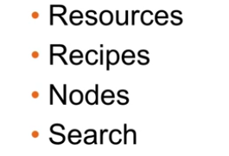
How to Manage Complexity?

Slide 5
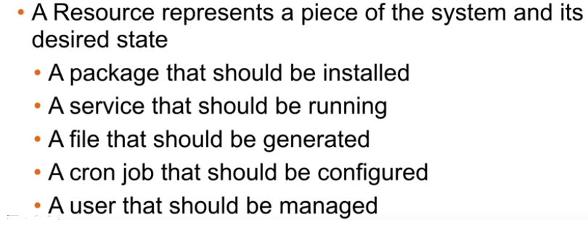
Resources

Slide 6
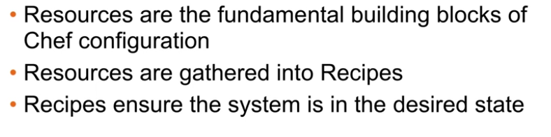
Resources in recipe

Slide 7
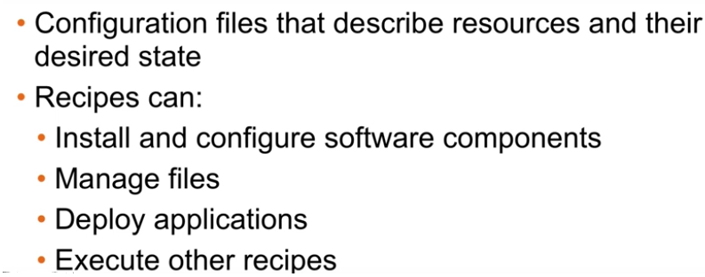
Recipes

Slide 8
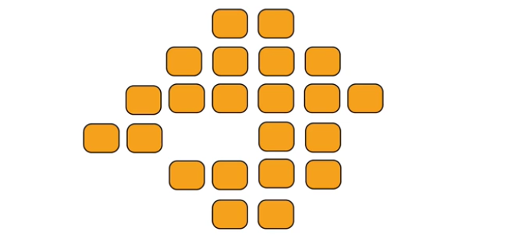
Nodes

Slide 9
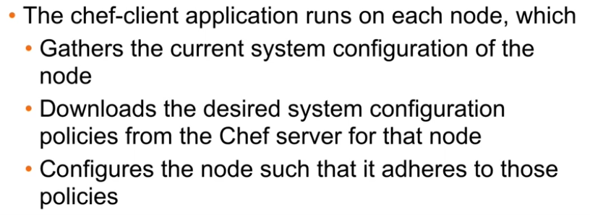
Nodes Adheres to Policy

Slide 10
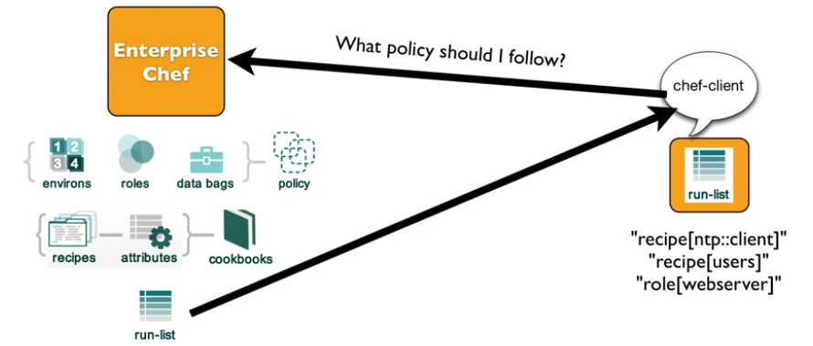
Run List

Slide 11
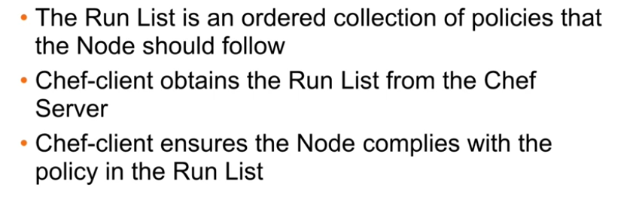
Run List Specify Policy

Slide 12
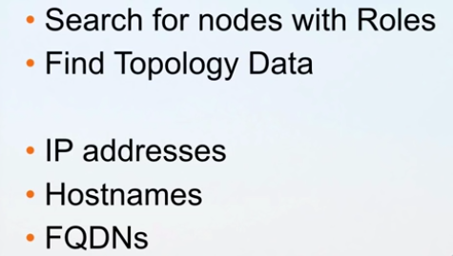
Search

Slide 13
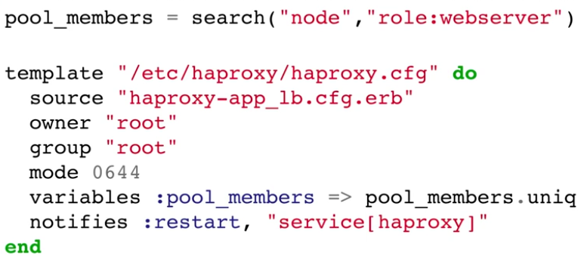
Search For Nodes

Slide 14
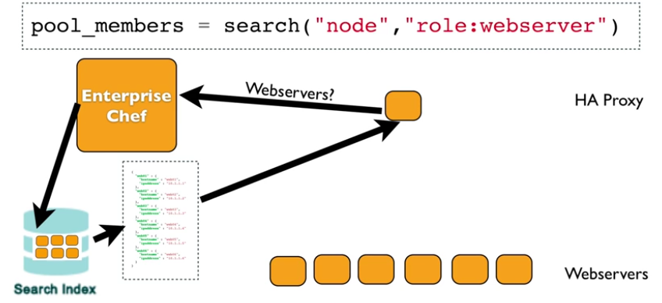
HA Proxy LB look for Web Server

Slide 15
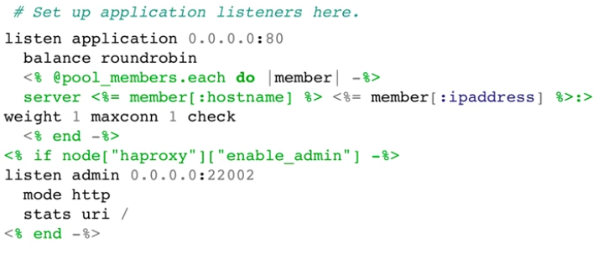
Pass result to HA Proxy template

Slide 16
HANDS ON Labs

Slide 17
Thanks!
Any questions?
You can find me at @username & user@mail.me

